Slide 1
Heart Disease Analysis

Slide 2
Project Details
Project Title | Heart Disease Analysis
Technologies | Data Science/Data Analytics
Domain | Healthcare
Project Level Difficulties | Intermediate
Language used | Python
Tools used | Jupyter Notebook, Power BI

Slide 3
Problem Statement
Health is real wealth in the pandemic time we all realized the brute effects of covid-19 on all irrespective of any status. You are required to analyze this health and medical data for better future preparation.
Do ETL: Extract- Transform and Load data from the heart disease diagnostic database You can perform EDA through python. The database extracts various information such as Heart disease rates, Heart disease by gender, by age. You can even compare attributes of the data set to extract necessary information.
Make the necessary dashboard with the best you can extract from the data.
Use various visualization and features and make the best dashboard Find key metrics and factors and show the meaningful relationships between attributes.

Slide 4
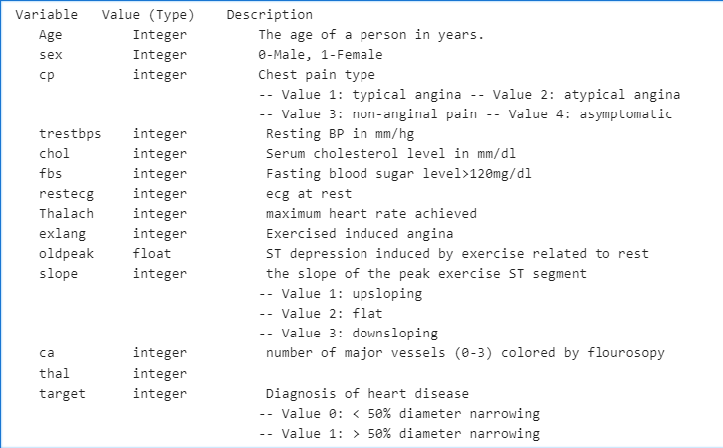
Details of the data:

Slide 5
Steps Followed
Data Collection
Importing Libraries
Loading Data
Missing Value Imputation
Data Cleaning
Insights
EDA
Modeling
Power Bi desktop
Reporting

Slide 6
Introduction
Health is real wealth in the pandemic time we all realized the brute effects of covid-19 on all irrespective of any status. You are required to analyze this health and medical data for better future preparation.
This data shows the heart disease among the population and other metrics.

Slide 7

Power Bi dASHBOARD​
NEXT

Slide 8
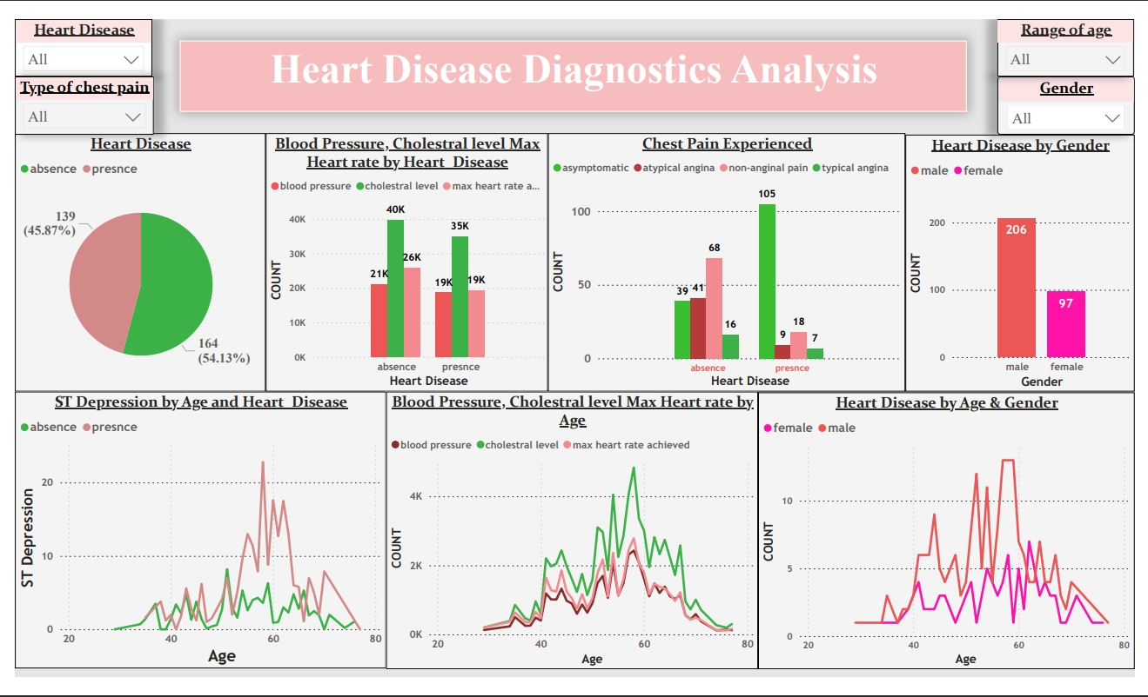

Dashboard

Slide 9
Insights:
Around 45.87% of the population suffers from heart disease.
Males Re more prone to heart disease
From the data it was observed that people having asymptomatic chest pain have higher chance of heart diseases.
It was also seen that male population has slightly higher BP.
we observed that the blood pressure is normal at 30 to 50 yrs of age and after 50 yrs it increases gradually to age of 60. And also after the age of 55 yrs it is fluctuating drastically.
It was seen that the Cholestrol level slightly starts increasing at the age after 45 and shows more flactuation in male than female
Depression level is quite high in the age group of 30 to 40 and 55 to 70. And in the age group of 40 to 55, it remains stable and females have slightly higher Depression

Slide 10
Key performance indiactor
Percentage of People suffering from Heart disease.
Heart Disease based on Age and Gender.
Type of chest pain in hear disease patients distribution of different types of chest pain.
Blood pressure and Cholesterol level of the people with Heart Disease according to age and gender.
ST depression experienced by the people according to the Age, Gender and absence or presence of Heart disease.

Slide 11

Conclusion: The male population in the higher age groups shows more cholesterol levels and blood pressure compared to the female . Also the male tend to have more angina induced due to exercise and also show higher st depression levels.

Slide 12
THANK YOU
https://github.com/peajangid
Priya Jangid
www.linkedin.com/in/priyajangid
priyajangid.data@gmail.com

